Slide 1
Future Trends in the Business of Women’s Health
Vicki A. Lucas, Ph.D., WHNP
President and CEO
Vicki Lucas, LLC
Women’s Health Business Consultants www.vickilucas.com
January 10, 2020
1:30 PM – 2:15 PM
Minneapolis, Minnesota

Slide 2
Objectives of the Presentation
Discuss the demographic trends and need for Women’s Health Services
Provide an overview of national trends in Women’s Health
Describe national female consumer preferences in Women’s Health Services
Discuss the business development opportunities in Women’s Health

Slide 3
Demographic Trends and Provider Need
Significant growth in midlife and senior women (>65)
Projected 6 – 10% increase in demand
Greatest growth in demand
  56% growth in need for Hispanic women
  18% growth in need for non-Hispanic women
States with greatest growth/need
  Nevada (↑ seniors)
  Arizona (↑ seniors)
  Washington (current shortage, ↑ population growth)
  Utah (current shortage)
  Idaho (current shortage)
  Florida (↑ seniors, ↑ population growth)
  North Carolina (↑ seniors)
  Texas (↑ population growth)
81% of OB/Gyn services devoted to childbearing age women (18 – 44)
Lack of adequate supply and expertise for midlife and senior women

Slide 4
Declining Births Heighten Competitive Landscape
Shift in Age Highlights Opportunity to Appeal to Changing Demographics
Total Births
United States, 2017
Birth Rate^{1,2}
National, By Age, 2015-2017
11%
In 2017, births declined for all age cohorts except for women over 40.
Decline in total US births since 2007
Births per 100 women
Ages under 20 and over 45 not shown
4

Slide 5
Midlife Services Provide Additional Growth Channel
Demand Projected to Grow for Urogyn, Breast Health, Osteoporosis
Key Midlife and 65+ Services Projected to Grow
Urogynecology
Breast Health
Osteoporosis
28%
5%
2%
Generation Z
Millennials
Generation X
Baby Boomers
Silent Generation
Born: 1997 and later
Ages: 21 and under
Size: 90.7M
Born: 1981-1996
Ages: 22-37
Size: 71.9M
Born: 1965-1980
Ages: 38-53
Size: 65.7M
Born: 1946-1964
Ages: 54-72
Size: 71.4M
Born: 1928-1945
Ages: 73-90
Size: 23.8M
Preventative and Behavioral Health
Women’s Primary Care
General Gynecology
Pregnancy Care and Obstetrics
Midlife Services
Geriatrics
US Population by Age, 2017
5

Slide 6
National Trends
↑ Women in Work Force
↑ Mid Life and Senior Women
  Aging with Dignity
  Quality of life
  Chronic illness
↓ Women of Childbearing Age
Delayed Childbearing
↑ Competition in Obstetrics
↑ Complex Pregnancies –Financial and Clinical Challenges
Freestanding Birthing Centers are “Skimming” well insured patients
↓ Number of Children
↑ Purchasing Power
↑ Education
↑ Expectations (Navigation, Integration and Convenience)
↓ Loyalty
↑ Use of Technology
↑ Specialization (REI, MFM, UroGyn, GynOnc Gyn Surgeons)
Women research, shop and share

Slide 7
Women Are Key Financial Contributors to Systems
Outspending Men Especially in Childbearing Years
Per Capita Health Care Spending by Age and Gender
2015
Largest gap seen in 19 to 44 aged cohort
Women
Men
7

Slide 8
Women’s Health Products Growth Projections
Declining | Growing
OB (Inpatient MFM, NICU) Inpatient Gyn Medicine Inpatient Gyn Surgery Inpatient Breast Surgery | Uro Gynecology Gyn Oncology Reproductive Endocrinology Outpatient Gyn Visits Breast Radiology Outpatient Gyn Surgery Outpatient Breast Surgery Outpatient MFM/Ultrasound/ Genetic Testing Ambulatory OB/Gyn Procedures Breast Oncology (Medical and Radiation) Women’s GI | Women’s Cardiology Women’s Sports Medicine Women’s Orthopedics Midlife Women’s Hormone Therapy Women’s Neuroscience Women’s Immunology Women’s Oncology (Non-Gyn and Breast) Women’s Internal Medicine Bone Density Adolescent Gynecology Infertility

Slide 9
Traditional OB/GYN Services to Remain Flat
Niche Gyn Onc and Surgical Gyn Shifting Outpatient
National Women’s Inpatient Growth Projections 2017-2022¹
Breast
n=57K
Higher Growth
MFM²
n=1.2M
General Gynecology
n=44K
Deliveries w/o complications projected to remain stagnant, while MFM deliveries, those w/ complications, projected to increase substantially.
Urogynecology
n=501K
Obstetrics
n=3.2M
Gynecologic Oncology
n=65K
Gynecological Surgery
n=285K
n-values represent 2017 estimated national volumes.
Includes high-risk OB.
9

Slide 10
All Outpatient Women’s Services Poised for Growth
As Population Ages, Midlife Demand Rising
National Women’s Outpatient Growth Projections 2017-2022¹
Higher Growth
n=2.9K
n=2.2M
n=3.2M
n=1.5M
n=9.1M
n=22.8M
n=39.8M
n=1.6M
n=37.2M
n=7.9M
n=7.9M
n-values represent 2017 estimated national volumes.
10

Slide 11
Gynecology Services Show Solid Margins
Hysterectomy and Uterine Fibroid Attractive Outpatient Procedures
Average Inpatient Contribution Margin by Women’s Sub-Service Line¹
Medicare, National, 2017 Q3 – 2018 Q2
Average Outpatient Contribution Margin by Women’s Sub-Service Line²
Medicare, National, 2017 Q3 – 2018 Q2
All sub-service line fall under the gynecology service line aside from urinary system under urology, breast procedures under general surgery, and medical cardiology
All sub-service lines fall under the gynecology service line aside from urolithiasis and urodynamics under urology, breast procedures under general surgery, and medical cardiology
11

Slide 12
Medicaid Business Challenges OB Financials
Increasing Pressure to Win Privately-Insured
Average Reimbursement by Birth
All-Payer Data per Insured Birth, 2017
53% difference in average cost per vaginal birth between cheapest and most expensive states¹
Medicaid Beneficiaries Challenge Margins
50%
48%
Alabama and Alaska
Of 16 total service lines, the 5 are Neurology, General Medicine, Ophthalmology, Rehabilitation, and ENT
Estimated percentage decrease in reimbursement for Medicaid vaginal births compared to private payer
Of all births attributed to Medicaid beneficiaries
12

Slide 13
New Birthing Sites Siphoning Off Favorable Patients
Proliferating Alternative Birthing Sites Attracting the Commercially Insured
Maternal Education Level by Place of Birth¹
CDC, 2017
Alternative Birthing Stats
84%
2007-2017 increase in at home or birthing center births¹
Hospital owned or affiliated birthing centers that have opened since 2013
55%
Insurance Status by Education Level²
n-value of freestanding birth center data is 19,878; n-value of hospital birth data is 3,793,272; n-value of home births is 38,343.
2017 US Census data.
85.5%
90.4%
Percentage of people with a bachelor’s degree with private health insurance
People with a graduate degree with private health insurance
13

Slide 14

Remaining Pregnancies Also Increasingly Complex
Chronic Disease, Opioids, and Insurance Changes Complicate Terrain
Chronic Conditions
Opioid Epidemic
Coverage Changes
Prevalence per 10K hospital deliveries, 1993-2014
433%
increase in rate of infant postnatal opioid withdrawal syndrome, 2004-2014
50%
increase in states with approved or pending work requirements waivers, up from 10 in April 2018 to 15 as of January 2019
Represents a 393% increase in hypertensive disorders
373%
increase in rate of recorded opioid use during pregnancy, 2000-2009
percent of low-income women who worked 1K+ hours last year and had months where they would not have met work requirements
27%
Associated with 36% increase in mean hospital charges for neonatal opioid syndromes
“Uninsured people with chronic diseases are less likely to receive appropriate care.”
-Institute of Medicine
75%
increase in opioid-related hospitalizations for reproductive-age women, 2005-2015
14

Slide 15

Female Consumer Preference
National Perspectives (N = >10,000)
Women select providers first
  #1 Family/friend in health care recommendation
  #2 Word-of-mouth (network)
  #3 Provider referral
  #4 Research
    Online ratings and reviews
    Ask network
    Online profile
  #5 Reputation
Quality is not a differentiator, it is assumed!
This Photo by Unknown Author is licensed under CC BY-NC

Slide 16

Women Select Hospitals Second
#1 Physician referral
#2 Family/friend in health care recommendation
#3 Word-of-mouth (network)
#4 Reputation
#5 Online research

Slide 17
Table 1. Obstetrics Preferences
Services | Facilities | Amenities | Model of Care
Natural childbirth options (birthing tub) OB ultrasound Childbirth education (childbirth prep, breast feeding) Preconception care Inpatient lactation services Anesthesia 24/7 Rooming-in with holding nursery High risk OB services (MFM) Inpatient OB/newborn services NICU services PP depression services Telehealth appointments Patient portal communications | Low risk family friendly “hotel like” facilities with high risk capabilities (LDRs then mother:baby rooming-in with NICU if needed) | Hotel like facilities Celebration dinner Comfortable sleeping accommodations for SO Family kitchen Refrigerator/mini-bar in room Massage Lullaby on PA system New mom trays Skype/Wifi | Personalized care! Natural childbirth CNMs Skin to skin Wireless monitoring Walking/labor lounge Physician continuity for delivery Integration across the perinatal continuum (pre-conception → post partum) Low risk with a safety net for high risk
Top Priorities:
#1 Personalized/coordinated care
#2 Customer service
#3 Provider continuity
#4 Lactation support
#5 Facilities
Women want high touch, low intervention birthing options with a large safety net!

Slide 18
Table 2. Women’s Services Preferences
Services | Facilities | Amenities | Model of Care
Breast services Mammograms Prevention/education Breast cancer services Gynecology services Gynecology cancer services Menopause services HRT Bioidentical hormones Midlife Women’s Services Senior Women’s services Osteoporosis services | “One Stop Shop” access to providers and most procedures and ancillaries in one place. Women’s Center/Breast Center. “Hotel like” facilities and ASC. | Coffee bar Gourmet snack bar Charging stations Kiosks – check-in and check-out Patient portal Text alerts and check-ins Boutique Paperless Women’s Resource Center Telehealth | Women centric care Integrated Navigated Personalized Coordinated Efficient Respectful Mind, body, spirit Strict customer service standards regarding wait time, cycle time, access to care and communication metrics

Slide 19
What Women Want . . .
Women’s Concepts Across Generations
Relationship oriented
Interdependent
Communication intense
Knowledge seeking
Emotional
Personal
Respectful
Intuitive
Wholistic
Trusted partnership

Slide 20
Facts About Women in Health Care
Women spend 3.5x more than men
Women utilize 2.5x more services than mem
2/3 of the top volume surgeries are specific to women
Women make 80% of the health care decisions for the family
The value of Women’s Services downstream revenue is 10x greater than direct Women’s Services revenue
Women are the majority of patients in the highest revenue specialties:
  70% orthopedics
  65% CV
  70% neuroscience
  70% oncology
  90% behavioral health
  60% sports medicine
  90% immunology

Slide 21
Unique Aspects of
Strategic Planning in Women’s Health
Gender based medicine
Trends in women’s consumerism
Multispecialty
Multidisciplinary
Healthcare employees engagement
Community perception
Female focused
Generation gap factor
Social networking technology
Inpatient facilities are a microcosm of the entire hospital

Slide 22
Key Factors in Women’s Services Planning
Infrastructure
Provider supply and support
Market Projections
Market Differentiation/Product Availability
Product Life Cycle

Slide 25
Women’s Health Specialties Across the Life Span
Adolescence 14 - 18 | Young Women 18 - 44 | Midlife Women 45 – 64 | Senior Women 65+
Adolescent Gyn Fertility Preservation for Cancer Patients Women’s Sports Medicine | Maternal Fetal Medicine Reproductive Endocrinology Infertility Fetal Centers Breast Specialists Women’s Sports Medicine OB ED OB ICU Laborists | Uro- Gynecology Gyn-Oncology Breast Specialists Breast Reconstructive Surgery Cosmetic Surgery Minimally Invasive Gyn Surgery Therapeutic Cosmetologists Women’s GI Specialists Women’s Cardiology Specialists | Uro- Gynecology Gyn-Oncology Breast Specialists Breast Reconstructive Surgery Women’s Orthopedic Specialists Women’s Cardiology Specialists Women’s GI Specialists Therapeutic Cosmetologists Women’s Internal Medicine Specialists

Slide 26
3 E’s of Business Development
Extend the Market
Expand the Products
Enhance the Core
26

Slide 27
Business Opportunities In Women’s Health
Uro-Gynecology (pelvic health) Gynoncology Orthopedics CV GI Brain Health (neuro-science) (Dementia) Birthing Centers | Navigators/Coaches Laborists Sports Medicine Minimally Invasive Surgery (MIGS) Loyalty Programs Women’s Centers Immunology | Technology Enabled Care Breast Centers High Risk Pregnancy Infertility Anti-aging OB ED Midlife Women’s Health Genetics
Note:
Women do not mind traveling for specialty care as long as they receive navigated and integrated care
Women expect all core services to be in one location (mammogram, ultrasound, bone density, urodynamics, lab, EKG, pre-op testing, and in-office procedures)

Slide 28
GYN Shoppers an Avenue to Long-Term Loyalty
GYN Patients Shop With Delivery in Mind
Three of Top Five Gynecology Preferences Related to Delivery
47%
Percentage of private payer new OB/GYN visits from self-referrals
1
The provider is in-network for my insurance
2
The provider delivers at a facility with good quality scores (ex. low C-section rate)
61%
Of childless respondents say they intend to use their gynecologist for future deliveries
3
The provider takes time to explain my condition and ways to stay healthy
4
The facility offers specialized services for babies (ex. NICU)
74%
Percentage of women who return to system where they delivered for other care
5
The provider delivers in a facility that offers birth options of my choosing
28

Slide 29
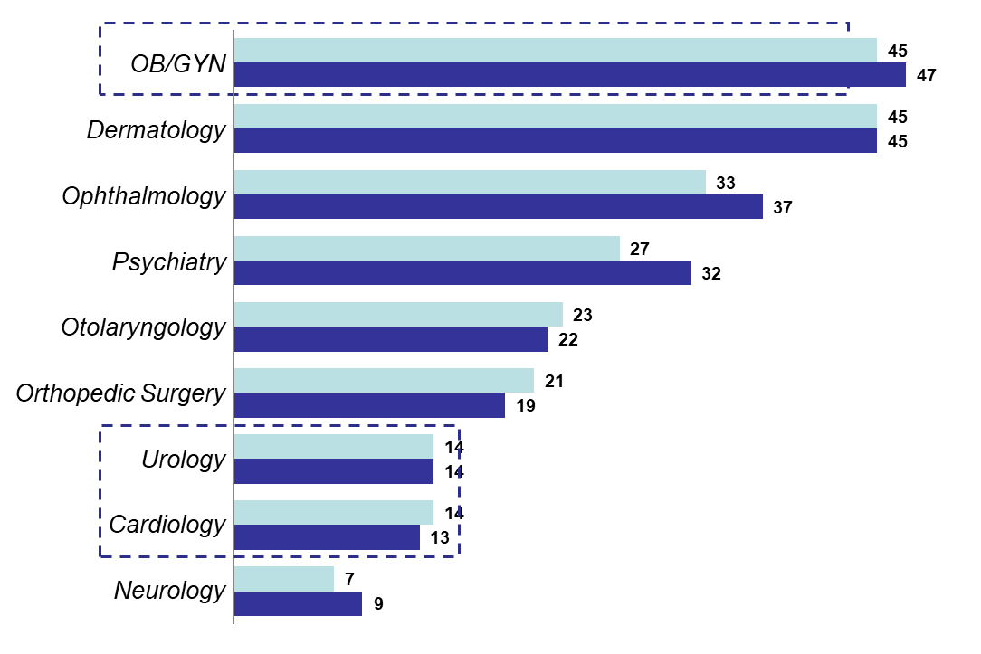
Women’s SL Growth Requires Dual Referral Strategy
Prioritize Consumer Attraction for OB, Traditional Referrals for Midlife
Percentage of All New Visits to Specialist That Resulted From Self-Referrals
Medicare
Private Insurance
Urology and cardiology are representative of typical women’s midlife and senior services, including urogynecology and women’s heart programs.
29

Slide 30
Keys To Success in the Business of Women’s Health
Integration, navigation and coordination (seamless patient transfers and warm hand-offs)
Increased access and convenience
Technology enabled care (telehealth, patient portal, etc.)
Effective communication
Brand ambassadors – employees, providers, patient (social media)
Deliver on patient experience 100%
Strengthen referral network integrity
Retain loyalty across lifespan and cross sell
Strengthen high risk OB, midlife and senior services
Provide alternative niche services (birthing center, pelvic health center, women’s health center, etc.)

Slide 31
Questions? Discussions?
Thank you!
The offer:
E-copy of slides
White paper on Business Development
Lipstick flash drive
Thirty-minute consultation
www.vickilucas.com
vicki.a.lucas@comcast.net
(410) 615-0062

